Slide 1
E-CANTEEN
TEAM:
23MX101-ABU SUFIYAN THAMEEM I
23MX212-KISHORE N K
23MX221-NIVED S
GUIDE:
Mrs. Maria Priscilla D
(Assistant professor
(Sr.Gr.))

Slide 2
AGENDA:
Project Overview.
Existing System.
Proposed System.
Modules Identified.
Technology and tools Overview.
Flow Diagram.
Database Schema.
Work Done so far.
UI design.
Timeline.
References.

Slide 3
PROJECT OVERVIEW
The application aims to develop a web application that manages the overall processes in the canteen.
It reduces manual work as well offers an online service of placing order of food items based on the choice of the end user.
The system provides online access to the end users thereby saving their time to place orders well in advance irrespective of their location.

Slide 4
EXISTING SYSTEM
The existing system is a cash and paper-based system that involves a lot of manual work that is prone to careless handling of data and orders.
The payment process in some cases could be time consuming if there are many users placing orders at the same time.
The existing system also provides uncertainties of food availability based on the time taken to place orders.

Slide 5
PROPOSED SYSTEM
The proposed system which automates the existing manual system by a web application that allows users to place instant orders well in advance online from any location thereby saving time and manual efforts.
To collect feedback from the users to improve the quality of the food product and services.

Slide 6
MODULES IDENTIFIED
USER MODULE :
PRODUCT MODULE-where users can view and access the products added by the admin.
ORDER MODULE-where users can place an order from the viewed products.
PAYMENT MODULE-where user pays for the ordered product.
ADMIN MODULE
PRODUCT MODULE-where the admin adds/updates the products.
USER MODULE-where admin manages the users.

Slide 7
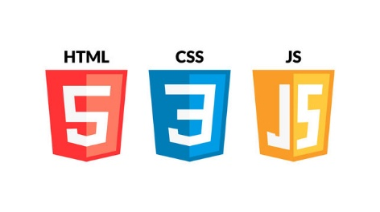
TECHNOLOGY & TOOLS OVERVIEW
HTML - It is the standard markup language for creating Web pages and describes the structure of a Web page.
CSS - It is used to style the web page layout and the user interface.
JavaScript - It is a client side scripting language used for validation.

Slide 8
TECHNOLOGY & TOOLS OVERVIEW
Node JS- is a cross-platform, open-source server environment that can run on Windows, Linux, Unix, mac OS and more. Node.js is a back-end JavaScript runtime environment.
MongoDB is a NoSQL database management application. NoSQL database systems offer an alternative to traditional relational databases using SQL.
VS code - Visual Studio Code is an open-source code editor that runs on Windows, Linux, and mac OS. It includes built-in features such as syntax highlighting, auto-complete etc.

Slide 9
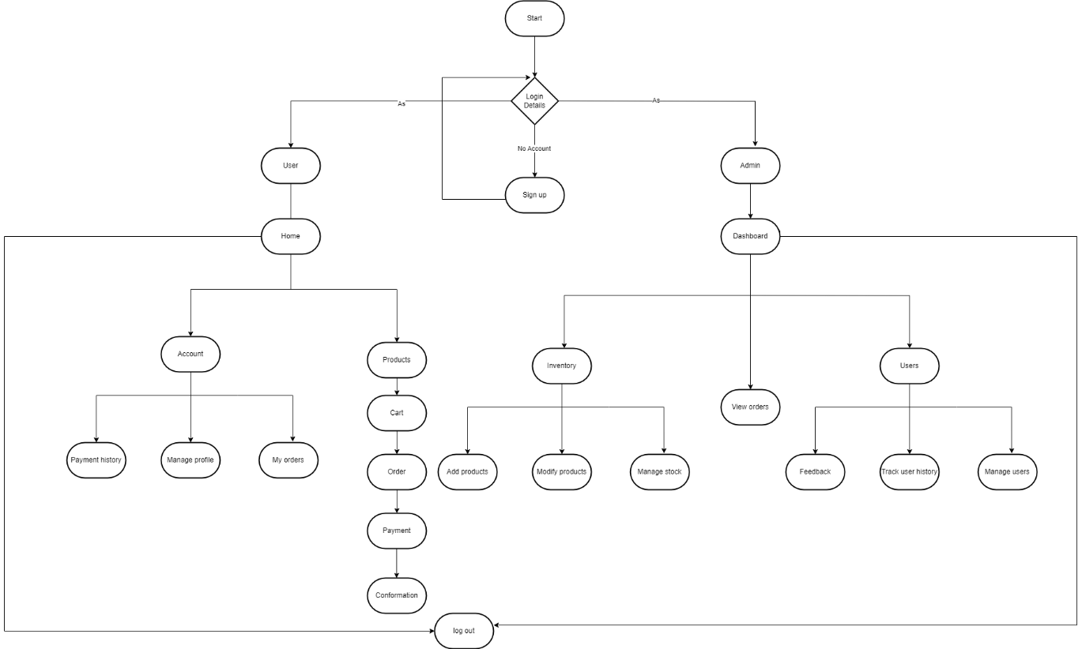
FLOW DIAGRAM

Slide 10
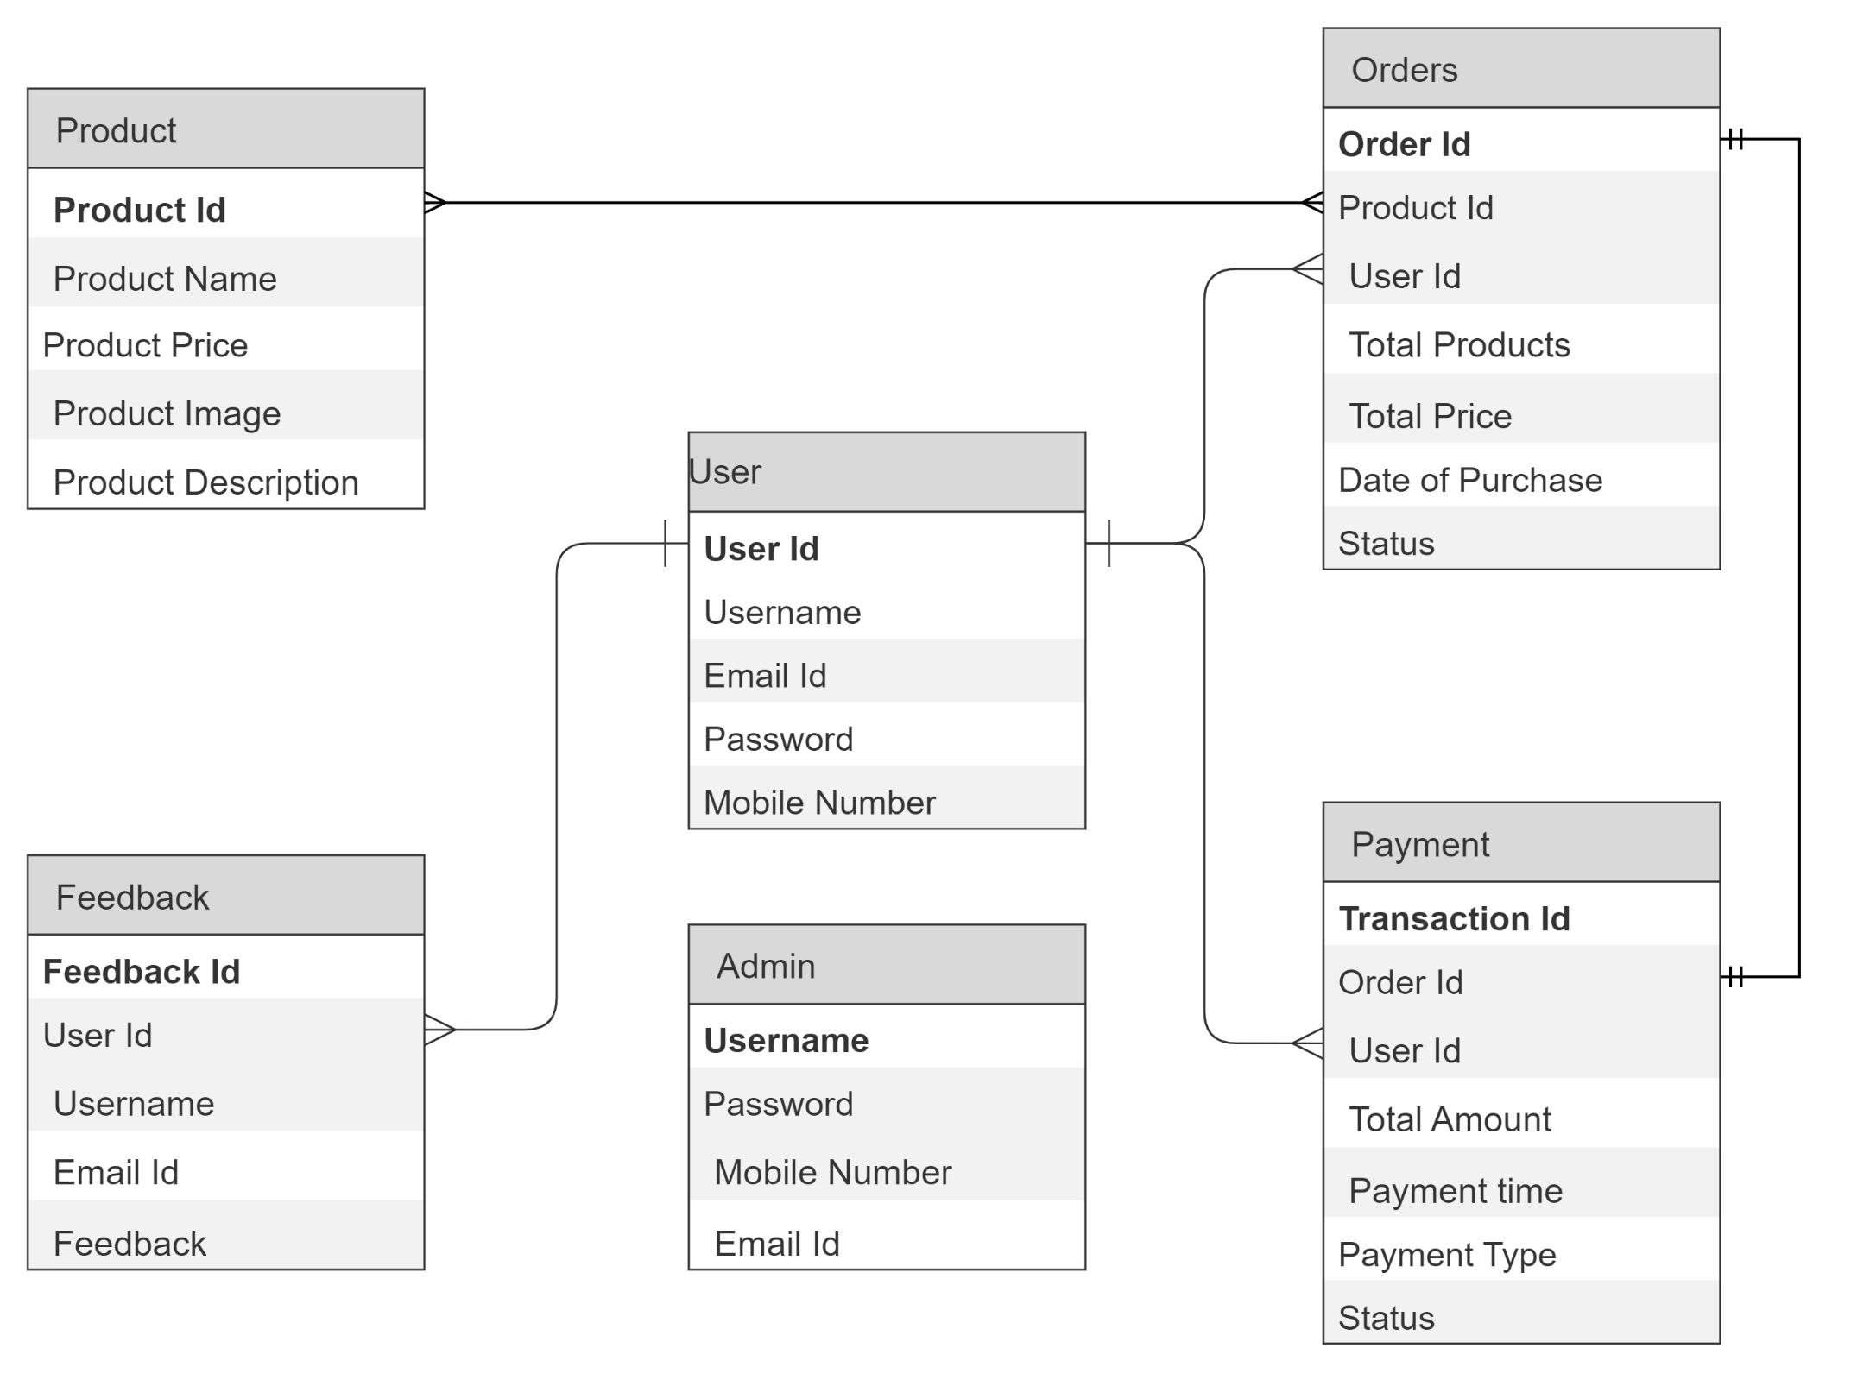
DATABASE SCHEMA

Slide 11
WORK DONE SO FAR
Developed a user interface that any user can access the web application from their own platform(eg.mac OS, windows)
Where the user interface consists of a home page in which the categories, about us and contact us sections are included.
The login feature is added where the registered user can login and new user can sign up using personal details.

Slide 12
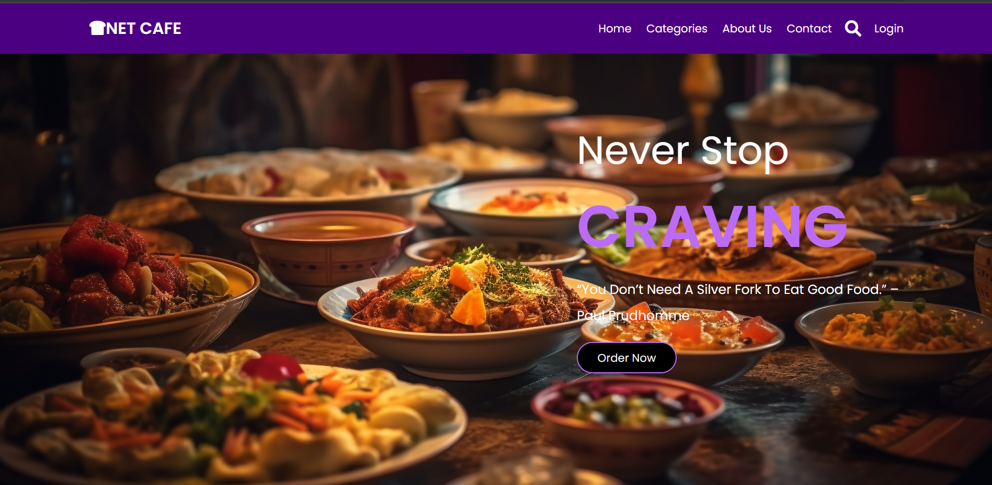
UI DESIGN

Slide 13
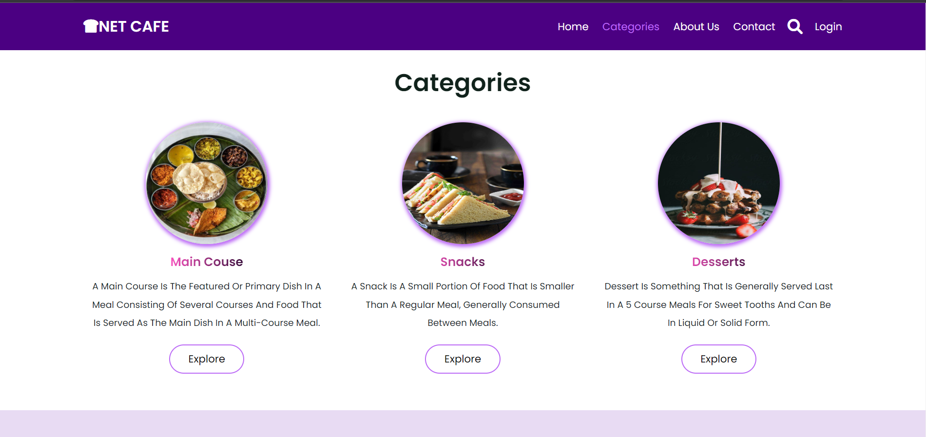
UI DESIGN

Slide 14
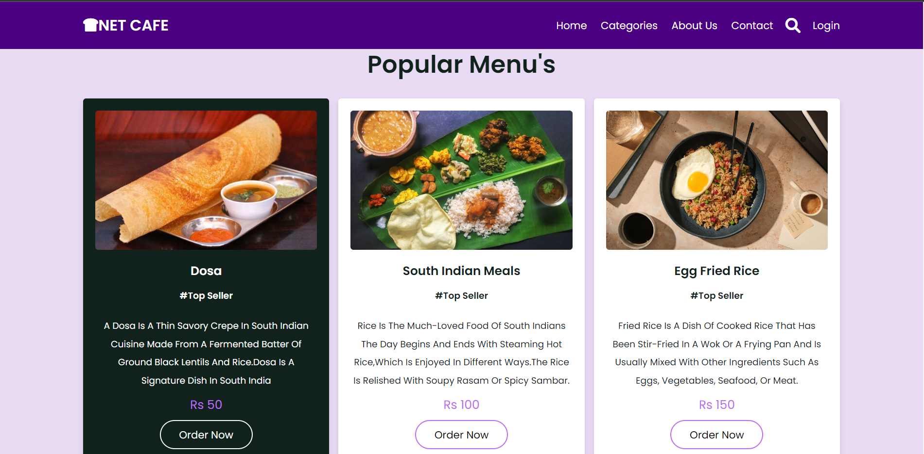
UI DESIGN

Slide 15
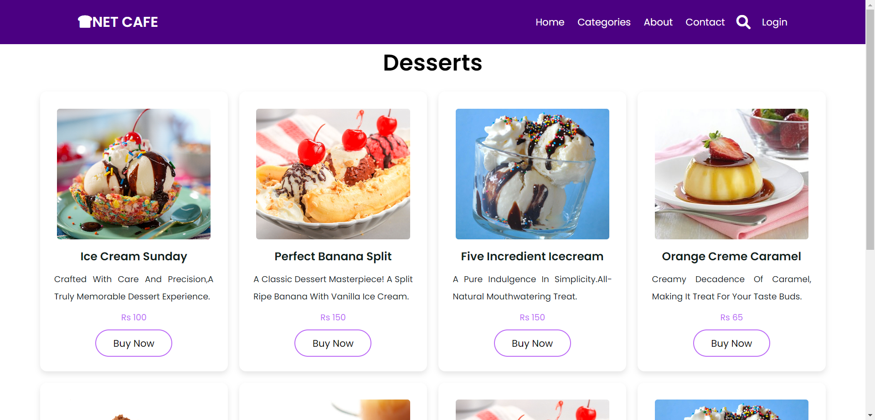
UI DESIGN

Slide 16
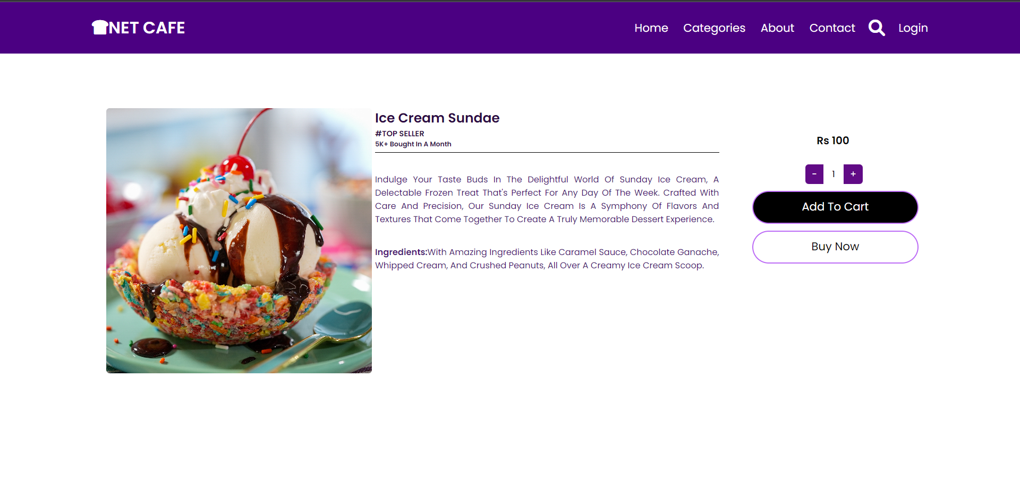
UI DESIGN

Slide 17
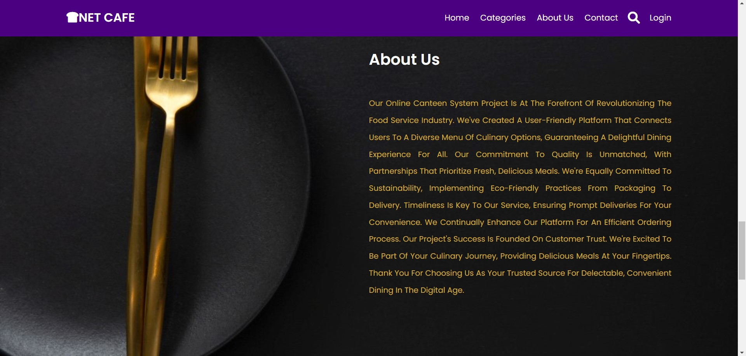
UI DESIGN

Slide 18
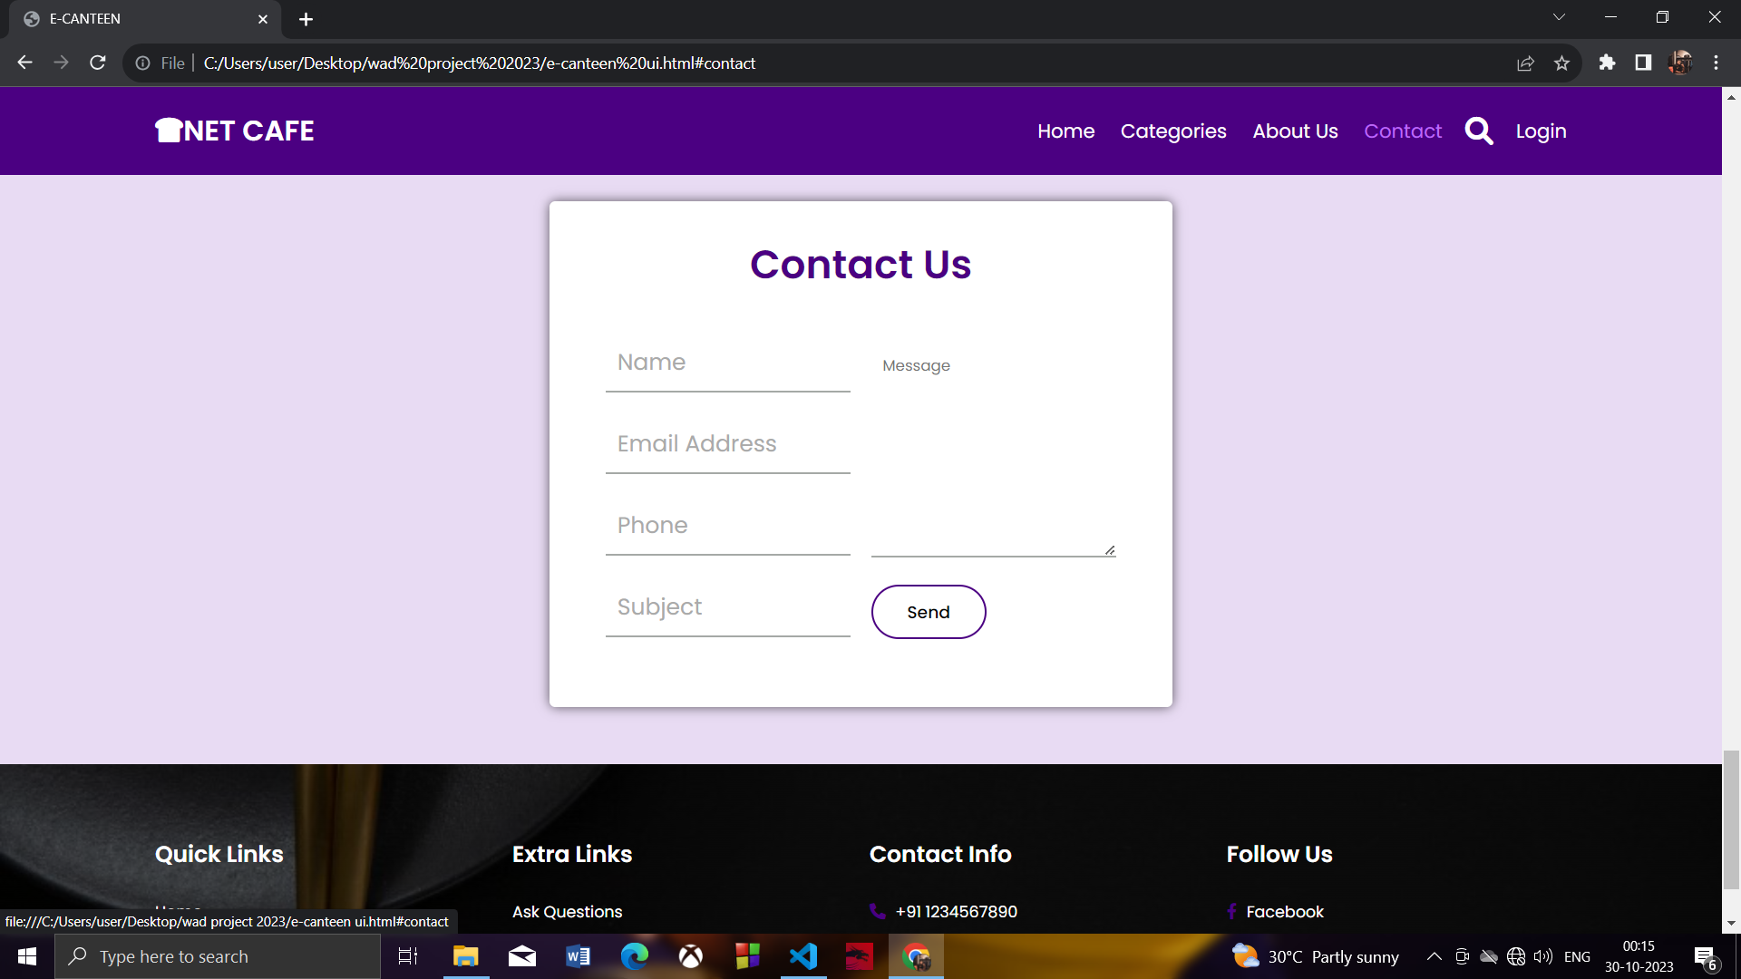
UI DESIGN

Slide 19
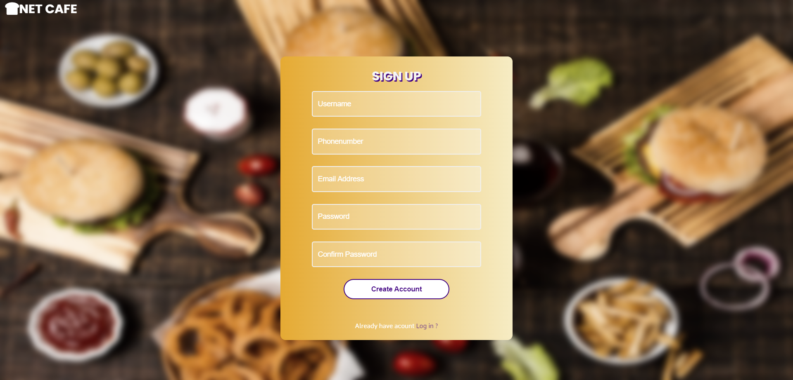
UI DESIGN

Slide 20
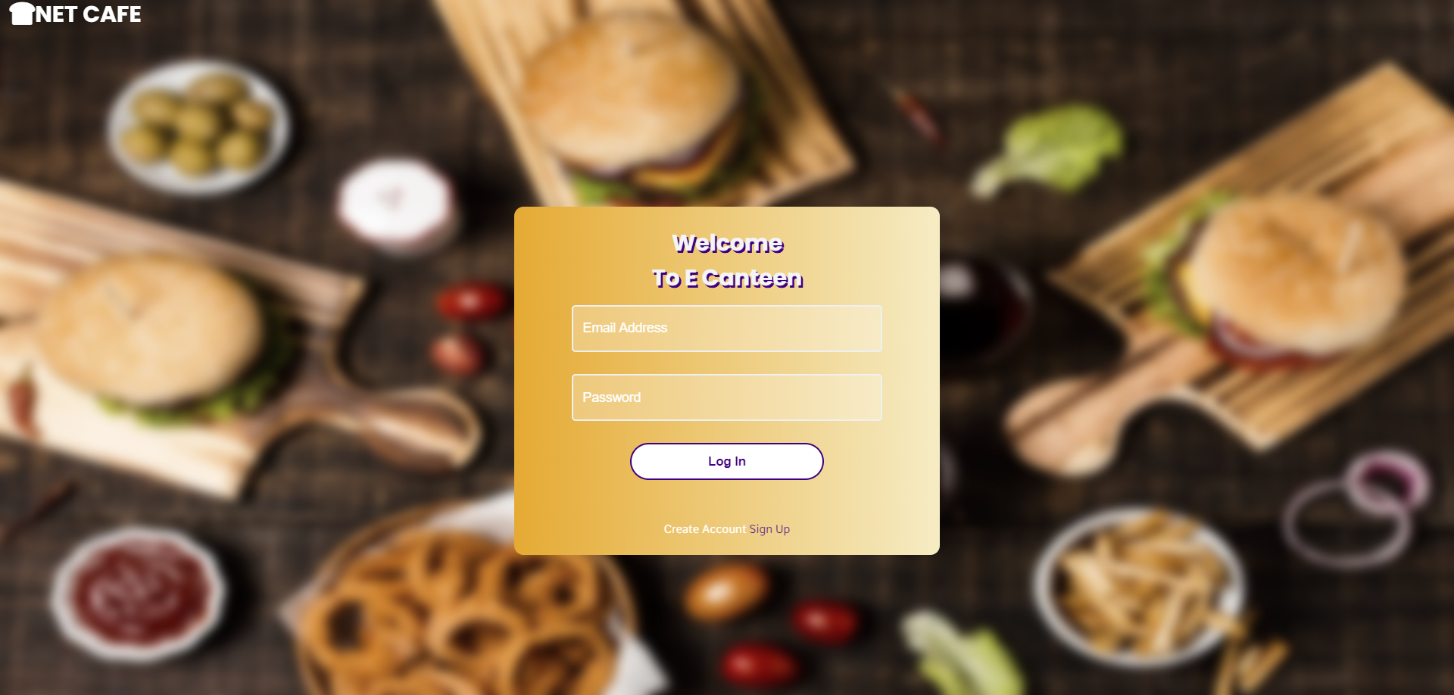
UI DESIGN

Slide 21
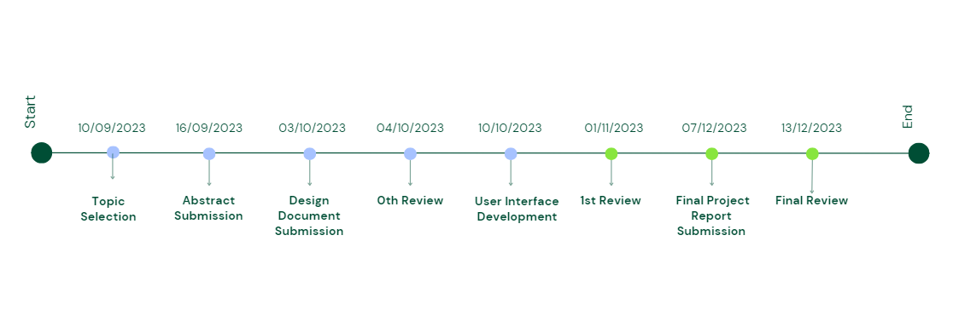
TIMELINE

Slide 22
REFERENCES
www.freecodecamp.com
www.github.com
www.w3schools.com
www.codecademy.com
BOOK REFERENCES:
Book: Programming JavaScript Applications.
Author: Eric Elliott.

Slide 23
THANK YOU!

